Slide 1
Electronic voting system
Group-5

Slide 2
Team Members
D .KEERTHI
NAVYASHREE.M
POOJA.B.N
SNEHA CHAWLE
RESHMA
ABHISHEK GHODEKAR
Trainer
MR.SUDHEER

Slide 3
Contents
Introduction to problem Statement
Plan
Technologies & Dependencies used
Modules/Services
Reference Diagrams

Slide 4

Introduction to problem statement
To Create an Application for electronic voting system.
Electronic Voting System(EVS) is an application to automate the process of planning and managing the voting system, as well as the actual voting activity.
EVS is defined with three types of users (Administrator, Electoral Officer & Voter), wherein all users need to login successfully before performing any of their respective operations.

Slide 5

Plan
Follow the Skeleton.
Discussion of problem.
Dividing the modules.
Completing and combining modules.
Testing.

Slide 6
Technologies Used
JAVA 8
Spring boot + Rest Controller + Jpa with Hibernate
PostgreSql
Swagger
Junit5

Slide 7
Modules & Services
User
Admin
Candidate
Election
Electoral Officer
Party
Schedule
Voter
Voter Request

Slide 8
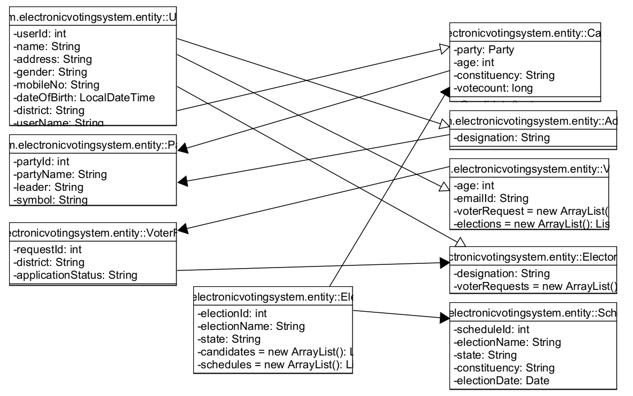
Class diagram

Slide 9
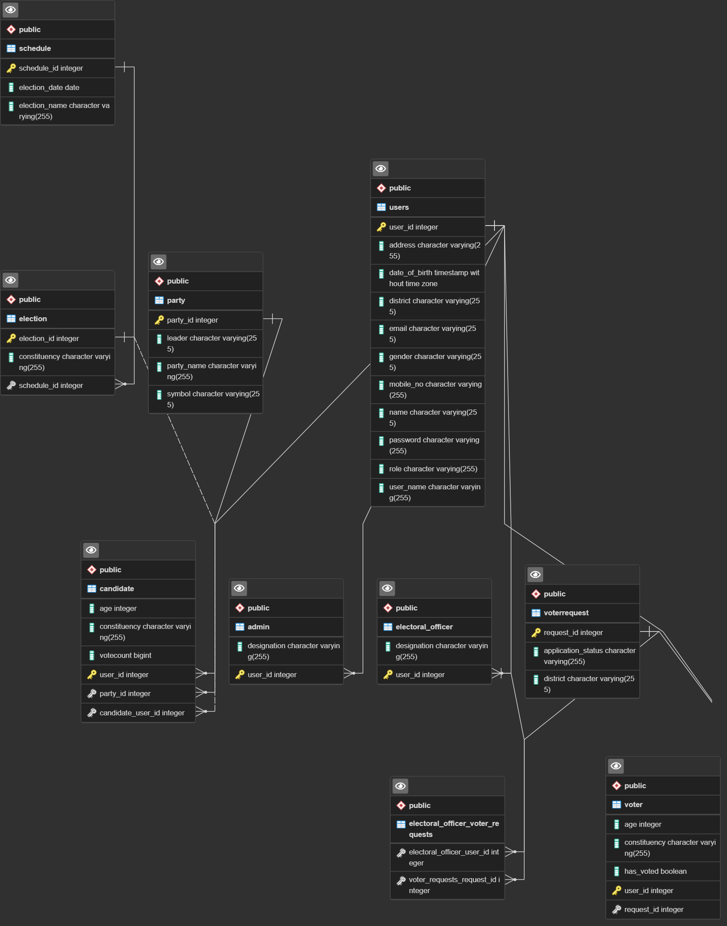

Slide 10

thankyou
capgemini.com

Slide 11
About Capgemini
Capgemini is a global leader in partnering with companies to transform and manage their business by harnessing the power of technology. The Group is guided everyday by its purpose of unleashing human energy through technology for an inclusive and sustainable future. It is a responsible and diverse organization of over 325,000 team members more than 50 countries. With its strong 55-year heritage and deep industry expertise, Capgemini is trusted by its clients to address the entire breadth of their business needs, from strategy and design to operations, fueled by the fast evolving and innovative world of cloud, data, AI, connectivity, software, digital engineering and platforms. The Group reported in 2021 global revenues of €18 billion.
Get The Future You Want | www.capgemini.com

